Slide 1
New Registration Process
Suggestions

Slide 2
Registration Process
User Completes the registration details
User clicks on “Continue” button
User is redirected to second page
User picks one of following options:
1 .Verify your account get your NG
2. Go to play game
1. Verify your account and get your NG
User goes to his personal e-mail account
User clicks on “verification link” that is sent by PB
User logs in the game; creates his character name and gets his NG prize
2. Go to play Game
User can directly log in the game without any verifications

Slide 3
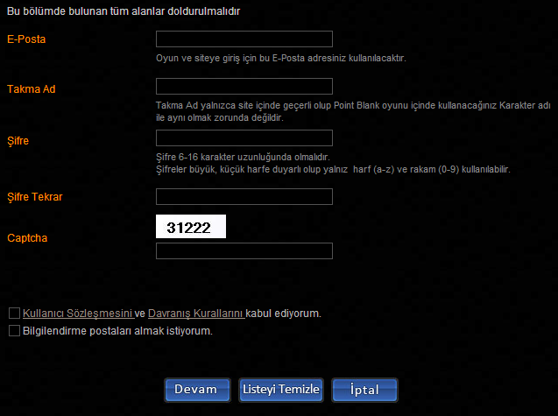
Registration Page
1. User will complete the form and will click on “Devam” (continue)
1

Slide 4
Registration Second Page
After user completes the form, he will be redirected to other page. On this page there will be 2 different options:
2. Verify your account and get your NG Code: If user selects this option, he will need to go to his e-mail account and verify his registered e-mail. After verifying his e-mail; NG or a chosen item will be injected to user account after he creates his character
3. Go to play game right away: User doesn’t need to verify his account. He can directly log-in the game and play the game
Verify your account and get your NG code!
2
Go to play game right away
3

Slide 5
Notes
This registration process will make online ads more effective. The process is taking too much time at the moment and users leave the landing page after they complete the registration section. They don’t want to spend time on e-mail verification.
If user selects to verify his account, he will get NG item; that way he will have chance to play with cash items so that he can purchase after he tries the cash items.
Giving out cash items will affect customers buying habit. They will go around the shop and will have knowledge about all cash items.

